Slide 1
PSY 102: Introduction to Cognitive Psychology
Day 1 (05/15/19): Science Communication

Slide 2
Today’s Goals & Agenda
Begin to build a supportive community.
Introduction to Instructor & Icebreaker
Discussion of syllabus, goals, and class norms
Define our approach to academic articles and the pursuit of scientific knowledge and apply this to an article critique.
Gallery Walk of various media on knowledge
Critique of Bem (2011)
Describe principles of good science communication.
Think Pair Share of articles on science communication
Apply to Yong (2019)
Identify brain regions that we will commonly come across.
Worksheet on brain regions

Slide 3
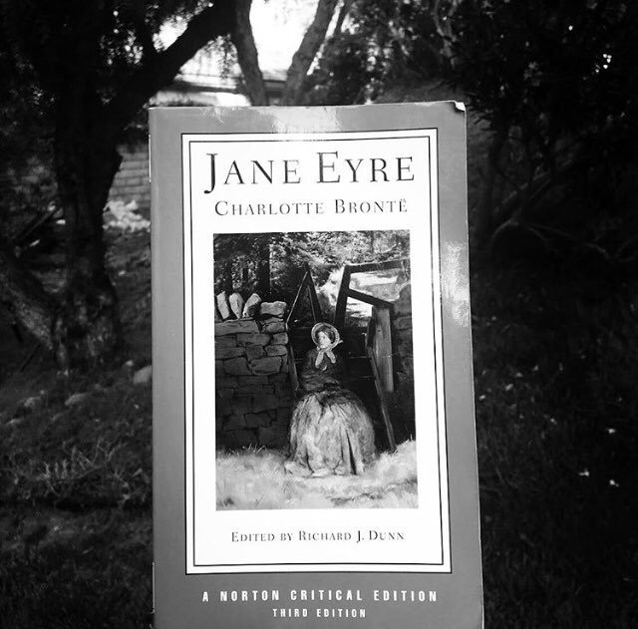
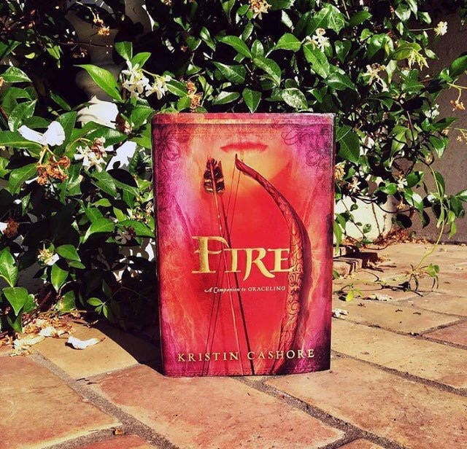
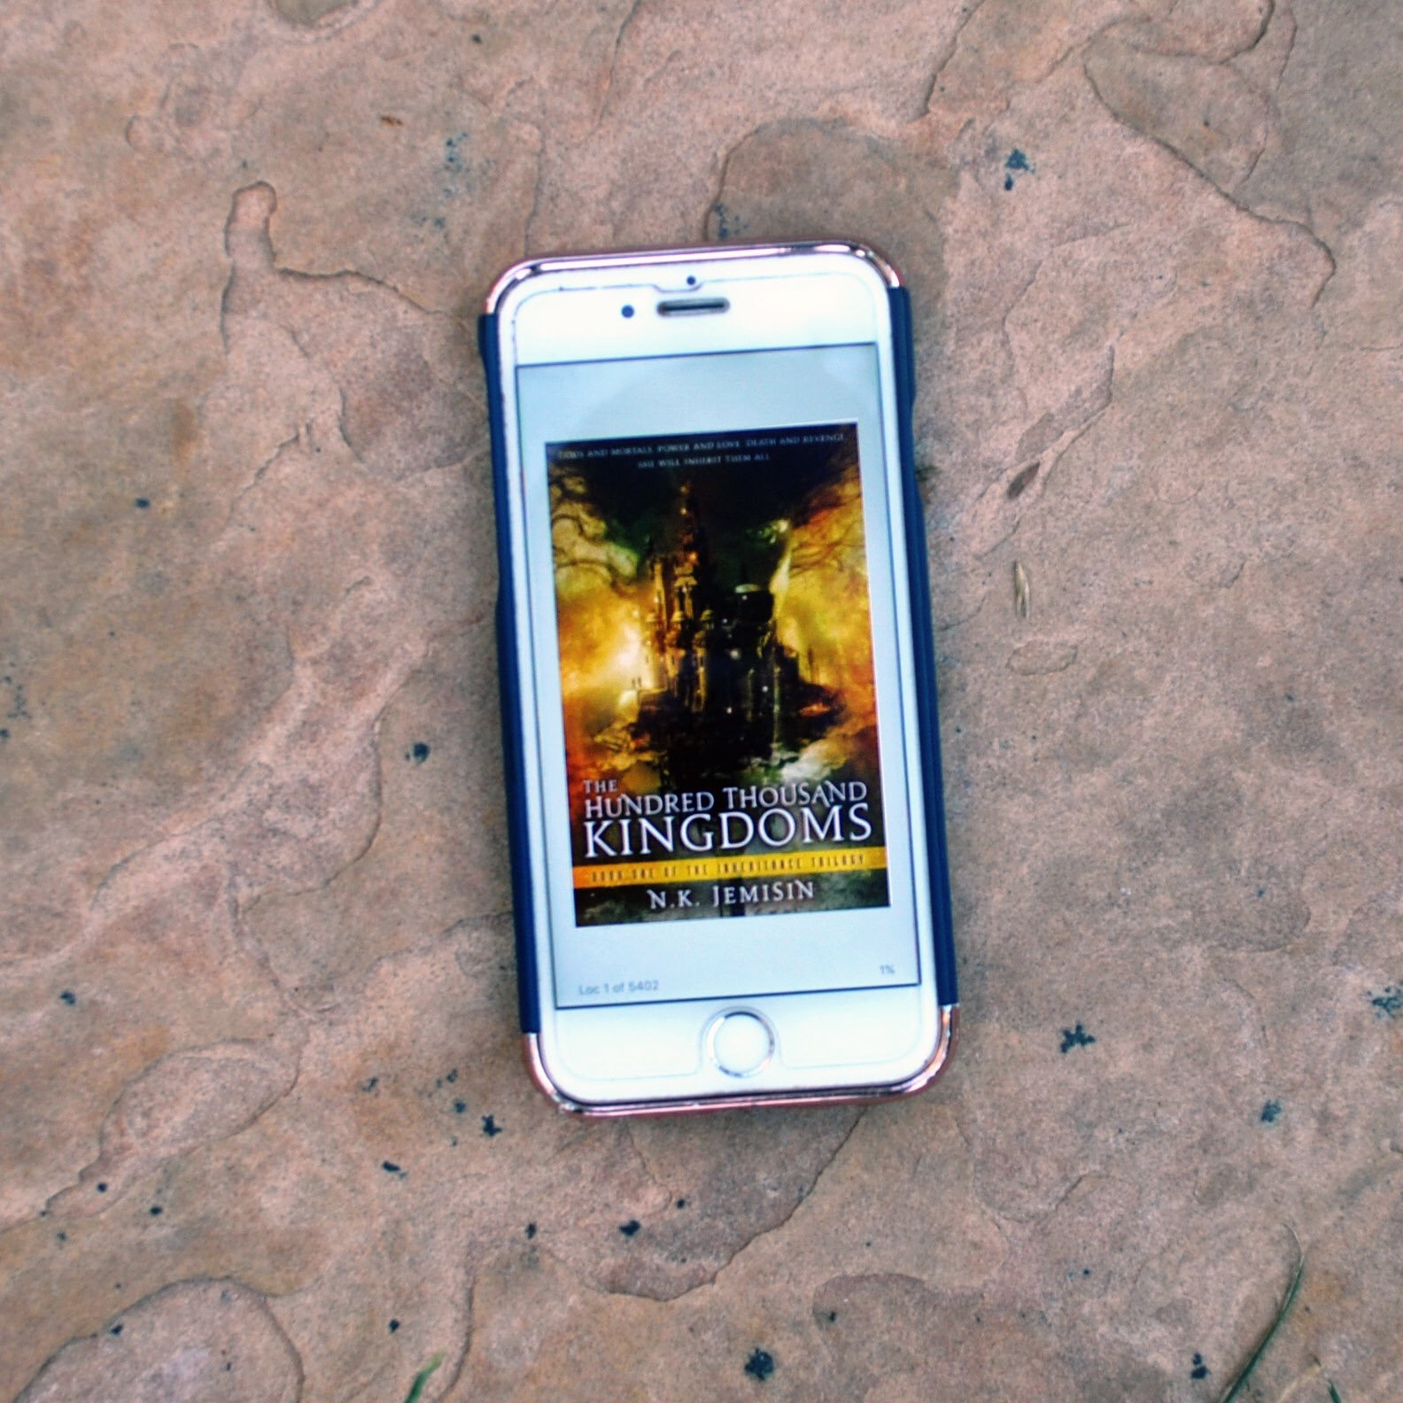
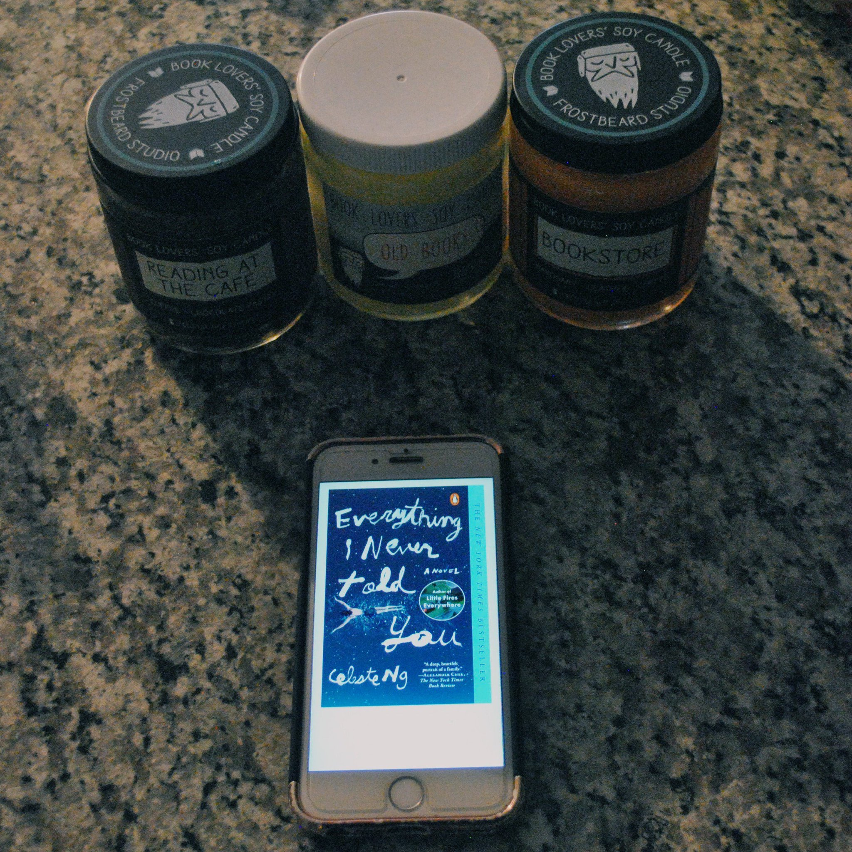


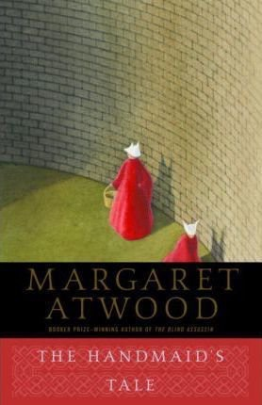
Christina Bejjani
christina.bejjani@duke.edu
Cognitive Psychology
B.A. neuroscience, Pomona College
Notes:
It’s always nice know a little about people you’re going to see every week. So, before I ask you to introduce yourselves to each other, here’s a little about me.
My name is Christina. I am a rising 4th year PhD student. That means I’ve been at Duke for the same number of years as a senior in undergrad. My specialty is cognitive psychology, which is why I’m teaching this class - to share my passion with y’all. My background is in neuroscience, among other things. And I asked y’all for fun facts, here are a few about me. I read a lot and have become that person who no one knows what to get, gifts-wise, so they just buy me gifts cards and more books. I have something like 200 unread books because of that. Look, they even buy me book smelling candles that I have never once lit. And these were the seven books I chose for a challenge about books that you love that you couldn’t review or explain why you loved them. And a fact about me no one really knows? Post college, my friend and I co-founded a social media site for book readers, but it never got off the ground.

Slide 4
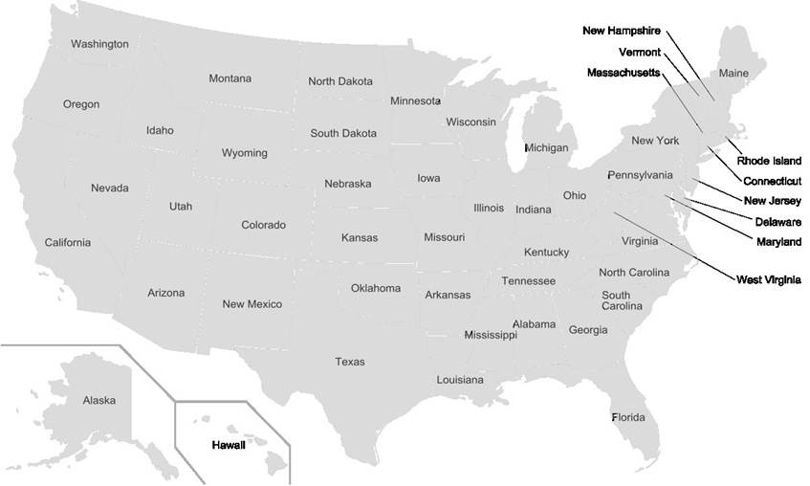
Notes:
C: I was born in Southern California and went to college in Southern California, at a tiny liberal arts college - Pomona College - and then moved to New Jersey, where I worked as a lab manager at Rutgers-Newark. Then I moved to Duke.

Slide 5
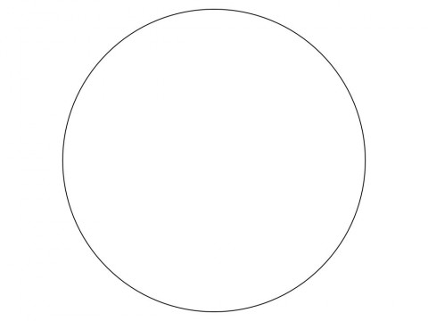
Notes:
What is a PhD?
So first, imagine a circle that contains all human knowledge...

Slide 6
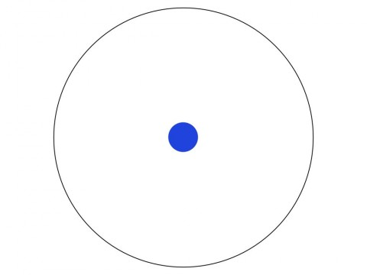
Notes:
By the time you finish elementary school, you know a little:

Slide 7
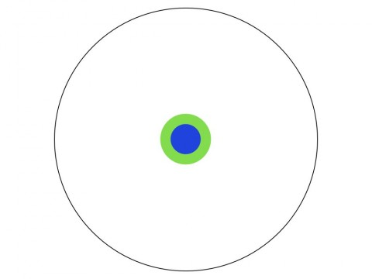
Notes:
By the time you finish high school, you know a bit more:

Slide 8
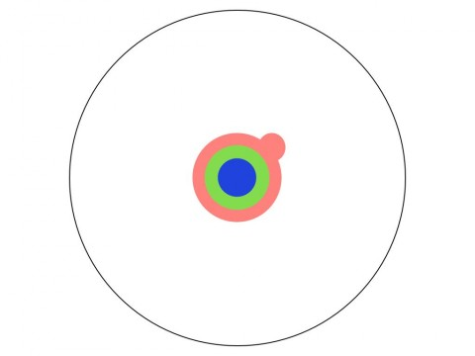
Notes:
With a bachelor's degree, you gain a specialty:

Slide 9
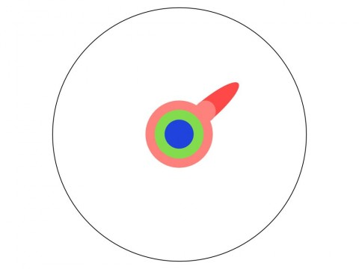
Notes:
A master's degree deepens that specialty:

Slide 10
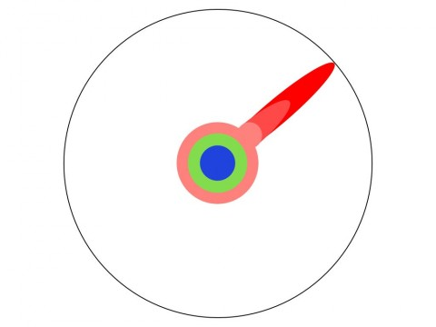
Notes:
Reading research papers takes you to the edge of human knowledge:

Slide 11

Notes:
Once you're at the boundary, you focus:

Slide 12

Notes:
You push at the boundary for a few years:

Slide 13

Notes:
Until one day, the boundary gives way:

Slide 14
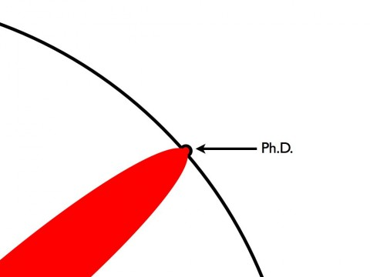
Notes:
And, that dent you've made is called a Ph.D.:

Slide 15

Notes:
Of course, the world looks different to you now:

Slide 16
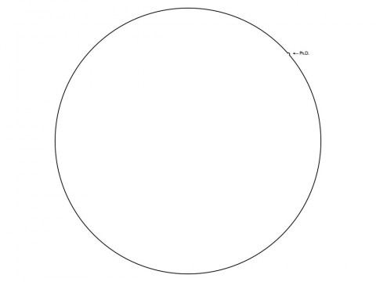
Notes:
: So, don't forget the bigger picture:

Slide 17
Your Turn
Flip over your notecard
Your mission is to find one of the people whose Hogwarts House does NOT match yours. Note that I made up Hogwarts results for two of you.
Introduce yourself by name to people you meet along the way.
Once you find your pair, introduce yourself (name, year, major, fun fact etc.) & discuss one or both of the hypotheticals on your slip.
Suggested: Exchange contact info with your pair, in case you need notes or have a question.
Notes:
https://www.cultofpedagogy.com/classroom-icebreakers/
Would you rather live in the country or the city?
Should all students be required to learn a second language?
Which is worse: bad breath or body odor? (did not write)
Would you rather be indoors or outdoors?
Which is better: Playing sports or watching sports? (did not write)
Would you rather travel every single day or never leave home?
Would you rather have a horrible short term memory or a horrible long term memory? (https://conversationstartersworld.com/would-you-rather-questions/)
Would you rather be able to control fire or water?
Would you rather be able to be free from junk mail or free from email spam for the rest of your life?
Would you rather have amazingly fast typing / texting speed or be able to read ridiculously fast?
Would you rather know the history of every object you touched or be able to talk to animals?
Would you rather have a completely automated home or a self-driving car?
Would you rather live on the beach or in a cabin in the woods?
-Find the person with a different Hogwarts House.
-Probably not the last icebreaker you’ll see.
-Critical to build a sense of community; at the minimum, we should learn each other’s names and feel comfortable sharing ideas in front of each other. And that’s really the goal of this and other ice-breakers, so keep that in mind as you do these activities.
-So you’ll find the person. And introduce yourself to people you meet along the way. If there’s any single person who can name everyone by name by the end of this activity, I’ll get you candy sometime this week for everyone in the class.
-Once you find the person, discuss the hypothetical on your notecard. We also suggest you exchange contact info.
-Are the instructions clear?

Slide 18
What are the goals of this class?
Become critical consumers of psychology in an open-minded, inclusive environment.
Develop skills as communicators of empirical cognitive psychology research.
Apply your skills to current issues within psychology at large, like pedagogical practices & open science.
My goal is that every student in this classroom is successful in PSY 102.
Notes:
Space to integrate ideas from our critical consumption of psychology; to take material from academic articles and think about how these ideas play out in the world, in your life, and in the lives of those around you; to communicate science to your loved ones and be able to talk about why cognitive psychology is so cool; to encounter new perspectives and new ideas and engaging and exploring those ideas in an inclusive and open-minded environment.
Taken from Brenda: My goal is to help you succeed, and for every student in this room to be successful, whatever that looks like to you. That might mean all of you get As, but it also might mean: you study efficiently enough to make time for other courses, or that you exit this class knowing whether or not you want to minor in psychology, or that you graduate and are able to an intelligent consumer of psychological research for your whole life.

Slide 19
To fulfill a requirement for my major. I would love to learn about how people think as well as how I react to that.
I'm hoping to learn more about how our brain/what structures in our brain affect our emotions and behavior, as well as truly decide if I want to pursue psychology after Duke.
I am hoping to have a more in depth look into cognitive psychology that enables me to learn more about how people think and why they think that way. I also am hoping to become a better thinker in order to better understand how the brain stores and processes information in order to later compare it to how a computer stores and processes information as well.

Slide 20
Quick Syllabus Review
Class meetings
Self-graded participation
Academic & nonacademic readings
Website: https://cogpsychduke2019.github.io
Weekly quizzes
Science Communication Pieces
Pitch, Duke Research Blog, Wikipedia project, Science Summary Piece
Generating rubrics together & changing grade percentages: supportive environment
Notes:
-talk about WHY this way (‘how do we know what we know?’ and 1970s articles)
-show them the website and go over
-Talk generally about supportive environment means letting students have agency

Slide 21
Class Norms
Engagement can take many forms:
●Responding to a prompt/question from others
●Building from other students’ contributions
●Asking clarification questions
●Nonverbal engagement (eye contact, nodding, other cues that indicate engaged listening)
In smaller breakout conversations/activities during section, engagement means:
●Contributing to the task at hand
●Working with group member(s) in a positive and respectful way
●Remaining present even once your group has finished the activity
Look at the participation form: https://forms.gle/fCR23HZmWfhDrYcq9

Slide 22
Summary: Class Norms
▷ Come to class on time.
▷ Engage with us while you’re here.
▷ Prepare for class.
▷ Support the learning of others.
▷ Assume best intent.
Notes:
Attendance is mandatory

Slide 23
Expect from me:
▷Support for your success in the course
○Background information
○Rigor
○Prompt replies (within 24 hours)
○Fair and useful feedback on writing
▷Maintain an engaging, enjoyable, and safe learning environment.
▷Assume best intent.
▷Resource for this class and beyond.

Slide 24
What is knowledge?
Define our approach to academic articles and the pursuit of scientific knowledge and apply this to an article critique

Slide 25
Gallery Walk:
What should we keep in mind while reading academic articles?
This isn’t a philosophy of science class, but what approach can we take towards scientific knowledge?
Notes:
· Although science is mostly distinguishable from pseudoscience, that might not be so evident to the public, and sometimes even the ‘safeguards’ of science fail (cc: Simine Vazire article; comic distinguishing the two and Wikipedia page)
· All models are wrong (e.g., StackOverflow page):
o Models are a simplified way to think about a structure or process and can help us understand, visualize, and explain a neurocognitive phenomenon.
o Even though all models are wrong, models can be predictively useful
· The public has certain conceptions of science, and some of the findings that they may have liked the most have turned out to be demonstrable false by the standards of science (e.g., Dorsa Amir thread)
o Science communication can create gaps between popular and real science if it is too sensationalized (e.g., headlines; Mozart effect)
· Stories of genius almost always have some underlying background context that we are missing (e.g., Albert Einstein thread)

Slide 26
What does this mean for us?
We are reading mostly academic articles, and many of them are recent. Some of them may not have had the benefit of time to establish reliability and validity.
Remember that science is always a team effort and is subject to human biases. Keep a critical eye out.
We will use models to think about how cognition is organized and generated, but all models are wrong. We can read papers with the assumption that they are wrong and then evaluate the evidence that support one model over another, over time.
Notes:
Check that they know reliability and validity

Slide 27
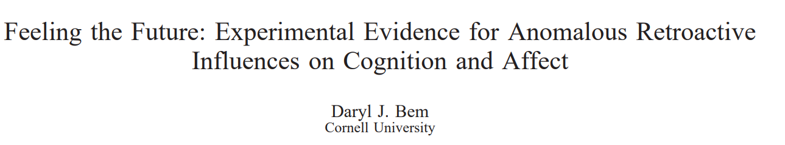
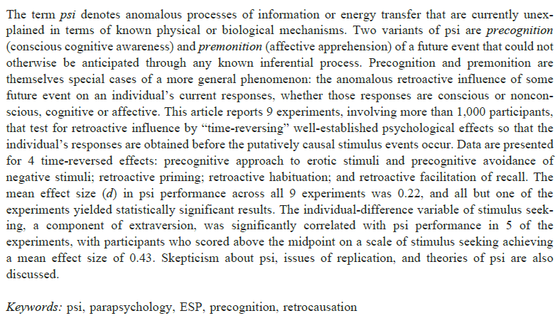
Bem, D. J. (2011). Feeling the future: experimental evidence for anomalous retroactive influences on cognition and affect. Journal of personality and social psychology, 100(3), 407-425

Slide 28
Sections of a Science Article
Abstract – Extract main question or take home point
Introduction – Necessary background for the experiment
Intro often has hypotheses. What are the experimenters looking for?
Methods – Explains the task and analytic techniques
Identifying the task is important, but math of the techniques isn’t
Results – Often includes a brief methods summary and lays out all results
Discussion – Explains the important results in general terms, mixed with connections to topics brought up in the introduction
Conclusion – Summary of the entire paper with reference back to “why this matters”

Slide 29
How to Read a Science Paper
Read the abstract!
Skim the introduction…
Jump to methods
Identify the task
Identify ‘contrasts’ of interest
Read through the results
Identify the figures
Evaluate what the figures tell you
Read through the discussion
Check out the introduction again
Notes:
No one method is correct
The abstract should tell you nearly all the interesting things about the paper, including why they did the experiment, what they expected to find, and what they found [beware of reading too much into their hypotheses though – these are often made post-hoc*]
No really, unless you’re trying to fit the finding into the context of past research, or find support for some of there more obscure hypotheses, you can often buzz right on by this section. Not to say that it’s useless, but might not be the best place to start
Jump to the methods and try to figure out what the task was. The abstract likely told you what they found, but probably not how they find it. Methods will tell you the task and likely contrast [Q: why are contrast important?]
Most papers can be understood from the figures alone. They should be able to clearly show the ‘key’ results wrt contrast of interest
Sometimes you read the results and you’re like huh, why should I care? The discussion section often addresses this question, w/ the researchers explaining their finding and why they think it is interesting or matters
Now it makes a bit more sense to through the why*

Slide 30
Critique of Bem (2011)
Read from Experiment 1 through to the section “Individual Differences” in the Results/Discussion
What do you notice about this article? What is it trying to study, and is it effective?

Slide 31
How can we best communicate our science?
Describe principles of good science communication.

Slide 32
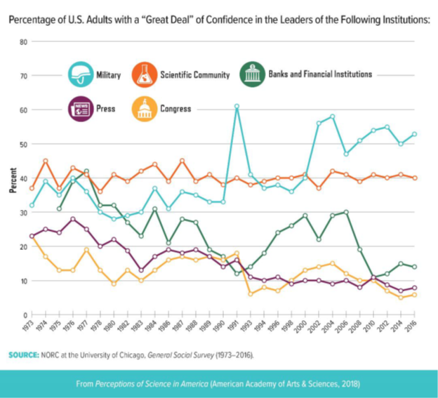
Notes:
· The problem isn’t that scientists aren’t trusted or respected

Slide 33
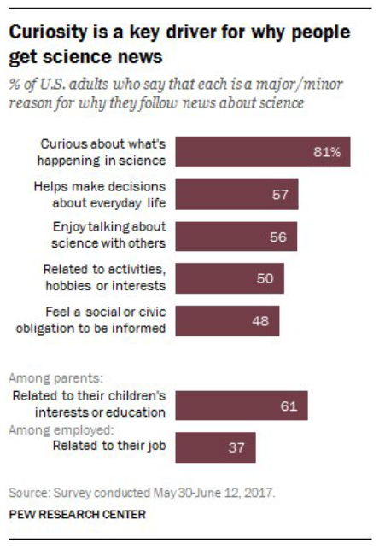
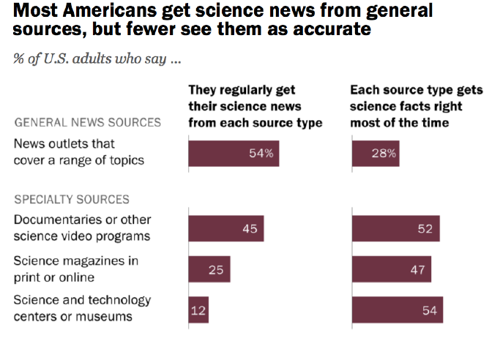
Notes:
36% of adults get science news a few times a week
30% say they actively look for science stories
Only 17% seek out science news on their own & read science stories a few times every week
Among those who seek out science news, a majority rely on general news outlets
Among those who are causal and uninterested news consumers, # soars (71 and 81)
Active news consumers are more likely to go to a specialized news outlet
· The public should have a more realistic understanding of who a scientist is, but scientists need to do the same for the public
· Social media matter

Slide 34
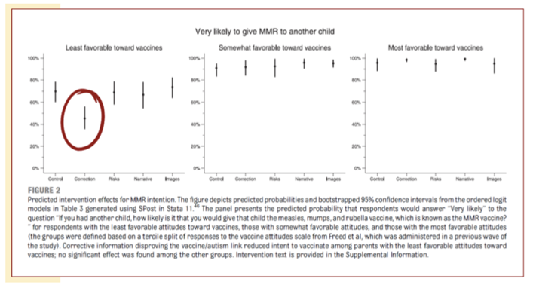
More Information Isn’t Enough
(cc: Nyhan et al. (2014), Pediatrics)
Notes:
From: Nyhan, B., Reifler, J., Richey, S., & Freed, G. L. (2014). Effective messages in vaccine promotion: a randomized trial. Pediatrics, 133(4), e835-e842.
“Refuting claims of an MMR/autism link successfully reduced misperceptions that vaccines cause autism but nonetheless decreased intent to vaccinate among parents who had the least favorable vaccine attitudes….”
Via Wikipedia (https://en.wikipedia.org/wiki/Information_deficit_model), the information deficit model (or simply deficit model) or science literacy/knowledge deficit model attributes public scepticism or hostility to science and technology to a lack of understanding, resulting from a lack of information. It is associated with a division between experts who have the information and non-experts who do not. The model implies that communication should focus on improving the transfer of information from experts to non-experts.
· More information does not equal greater acceptance of science

Slide 35
Think Pair Share: What is good science communication?
Read the article(s) on Science Communication that you received at the start of class; extract principles of good science communication.
After 5 minutes or so, I’ll tell you to share what you found in your article with the person next to you.
We’ll then come together as a class to generate a sheet of principles of good science communication that we will follow along with our readings over the course

Slide 36
Brain Labeling Worksheet
Identify brain regions that we likely will come across in our readings

Slide 37
Today’s Goals & Agenda
Begin to build a supportive community.
Introduction to Instructor & Icebreaker
Discussion of syllabus, goals, and class norms
Define our approach to academic articles and the pursuit of scientific knowledge and apply this to an article critique.
Gallery Walk of various media on knowledge
Critique of Bem (2011)
Describe principles of good science communication.
Think Pair Share of articles on science communication
Apply to Yong (2019) – did not get a chance to do
Identify brain regions that we will commonly come across.
Worksheet on brain regions

Slide 38
Tomorrow’s Work
Chapter & Articles
Gazzaniga, M., Ivy, R.B., Mangum, G.R. (2008). Methods of Cognitive Neuroscience. In: Cognitive Neuroscience: The Biology of the Mind, pp. 110-162. New York City: W.W. Norton & Company Third Edition. PDF here
Lab Manual PDF here.
Darling, N. (2017). Attracting WEIRD Samples. Retrieved from Psychology Today website: https://www.psychologytoday.com/blog/thinking-about-kids/201710/attracting-weird-samples PDF here
Ted Talk:
Goldacre, B. (2011). Battling bad science. Retrieved from https://www.ted.com/talks/ben_goldacre_battling_bad_science

Slide 39
Self-rated Participation & Reflection on Class
https://tinyurl.com/PSY102Participation
https://tinyurl.com/PSY102MinutePaperMay15

